Slide 1

Design
Pablo Schmeiser, Alexander Möhring, Tim Wolk, Adham Gouda, Dominik Jentsch

Slide 2
Organisation
Same as last phase:
weekly meetings
review of work
distribution of tasks
Tools:
Overleaf
Notion
UMLet
Pablo Schmeiser, Alexander Möhring, Tim Wolk, Adham Gouda, Dominik Jentsch

Slide 3
Architecture
Pablo Schmeiser, Alexander Möhring, Tim Wolk, Adham Gouda, Dominik Jentsch

Slide 4
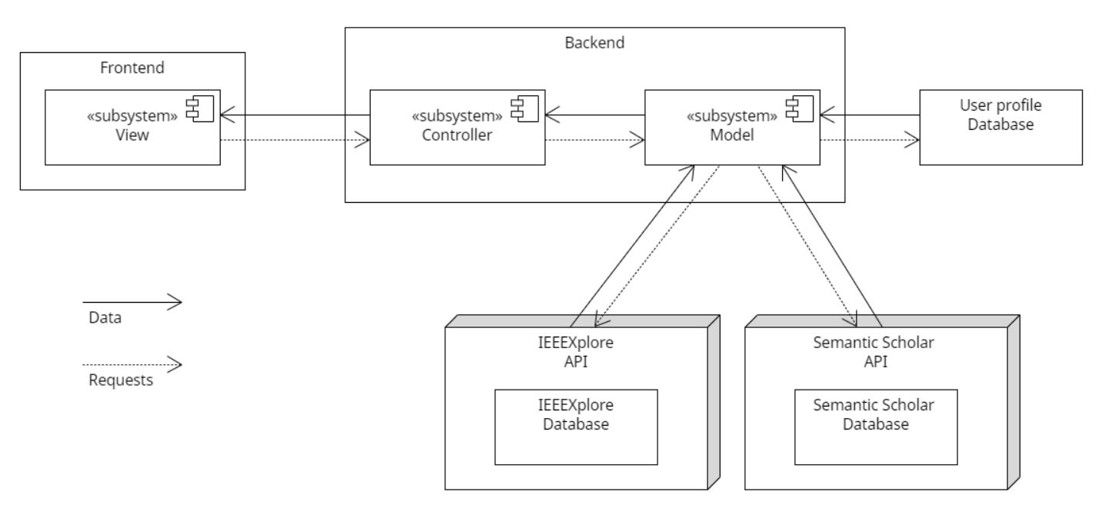
Pablo Schmeiser, Alexander Möhring, Tim Wolk, Adham Gouda, Dominik Jentsch

Slide 5
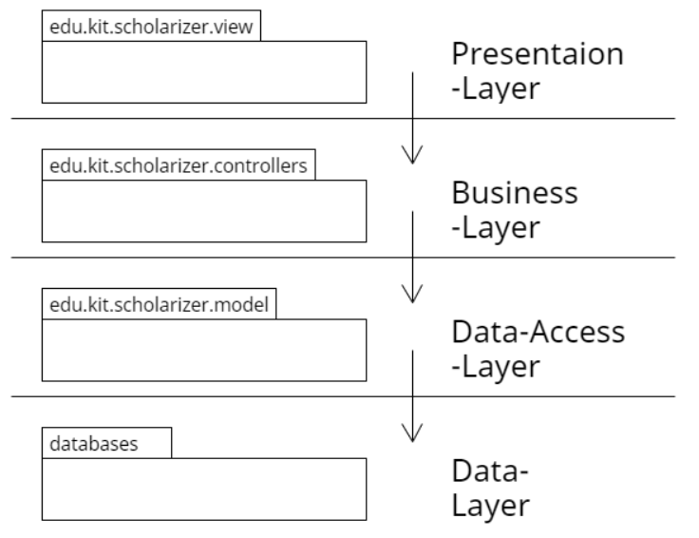
Pablo Schmeiser, Alexander Möhring, Tim Wolk, Adham Gouda, Dominik Jentsch

Slide 6
Components
Pablo Schmeiser, Alexander Möhring, Tim Wolk, Adham Gouda, Dominik Jentsch

Slide 7
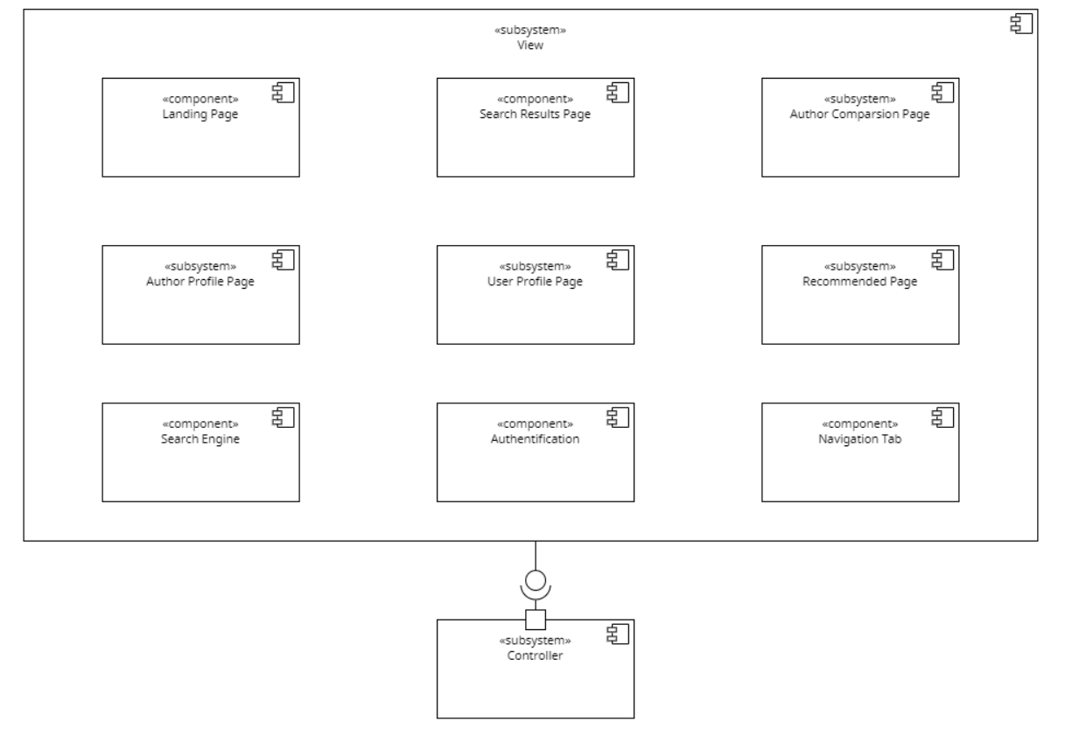
Components - View
Pablo Schmeiser, Alexander Möhring, Tim Wolk, Adham Gouda, Dominik Jentsch

Slide 8
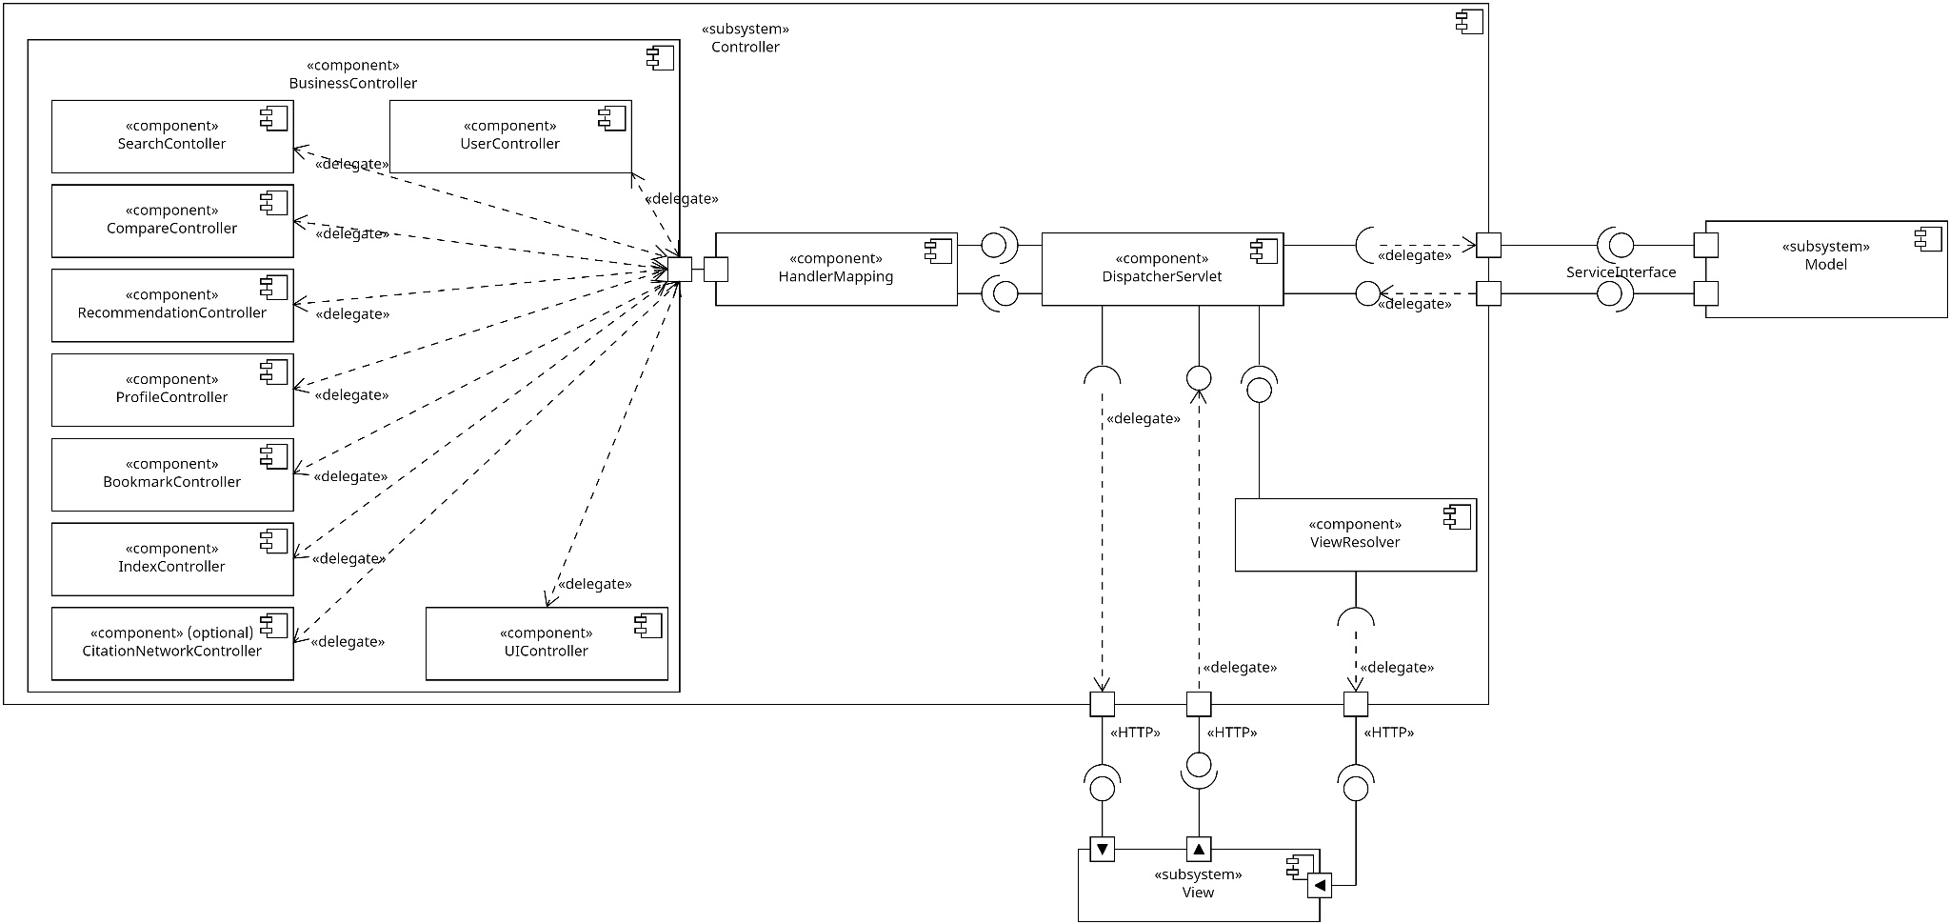
Pablo Schmeiser, Alexander Möhring, Tim Wolk, Adham Gouda, Dominik Jentsch

Slide 9
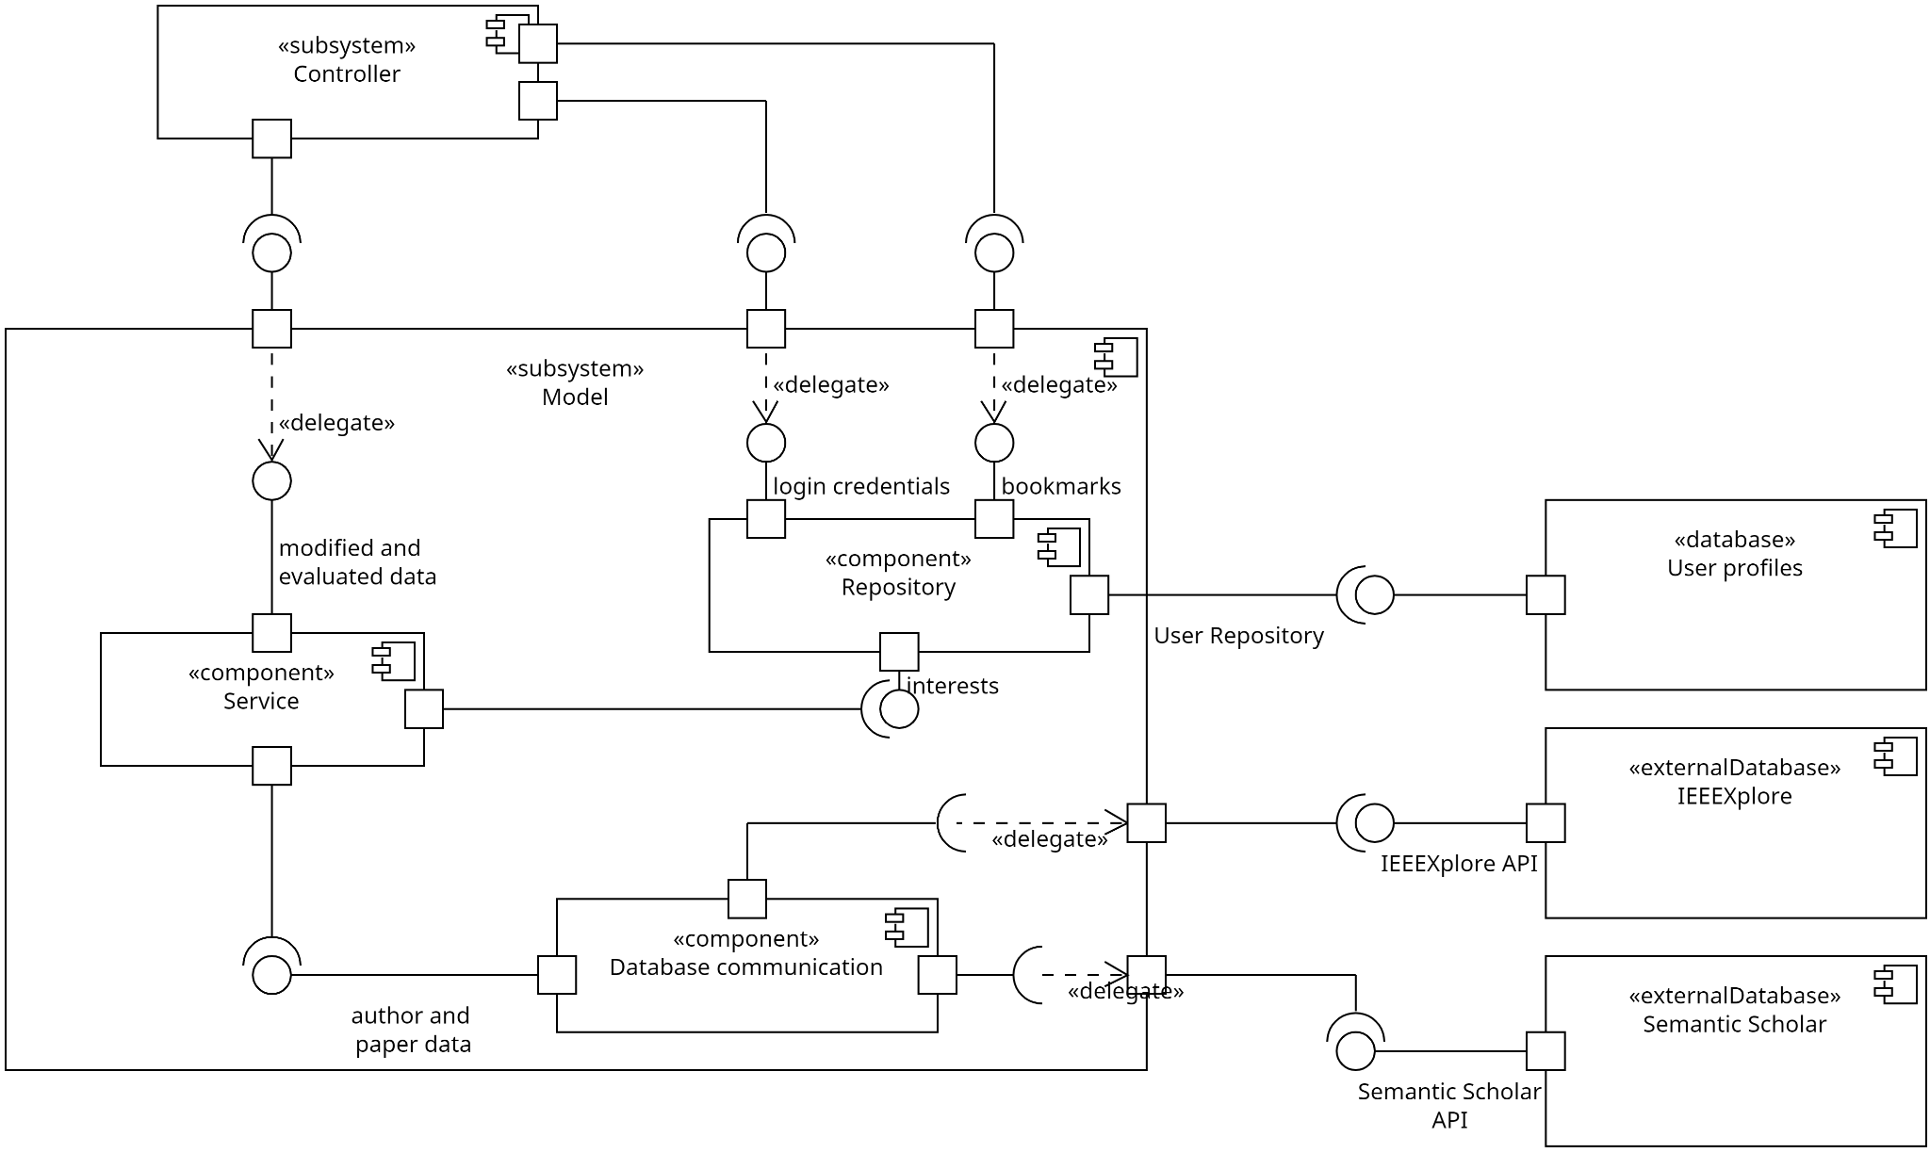
Pablo Schmeiser, Alexander Möhring, Tim Wolk, Adham Gouda, Dominik Jentsch

Slide 10
Database design
Pablo Schmeiser, Alexander Möhring, Tim Wolk, Adham Gouda, Dominik Jentsch

Slide 11
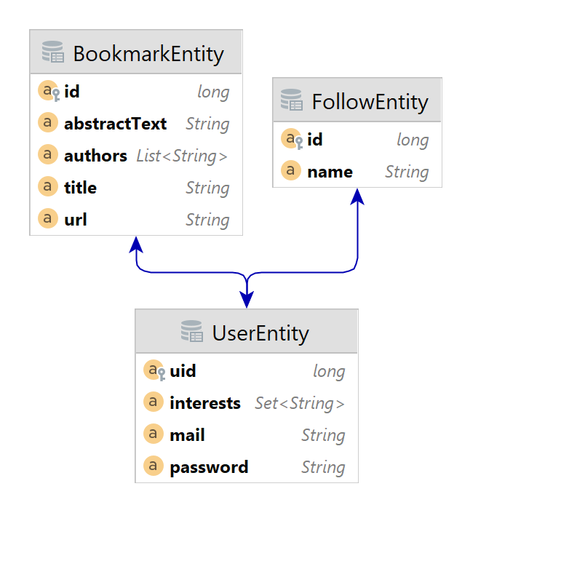
Pablo Schmeiser, Alexander Möhring, Tim Wolk, Adham Gouda, Dominik Jentsch

Slide 12
Packages and Classes
Pablo Schmeiser, Alexander Möhring, Tim Wolk, Adham Gouda, Dominik Jentsch

Slide 13
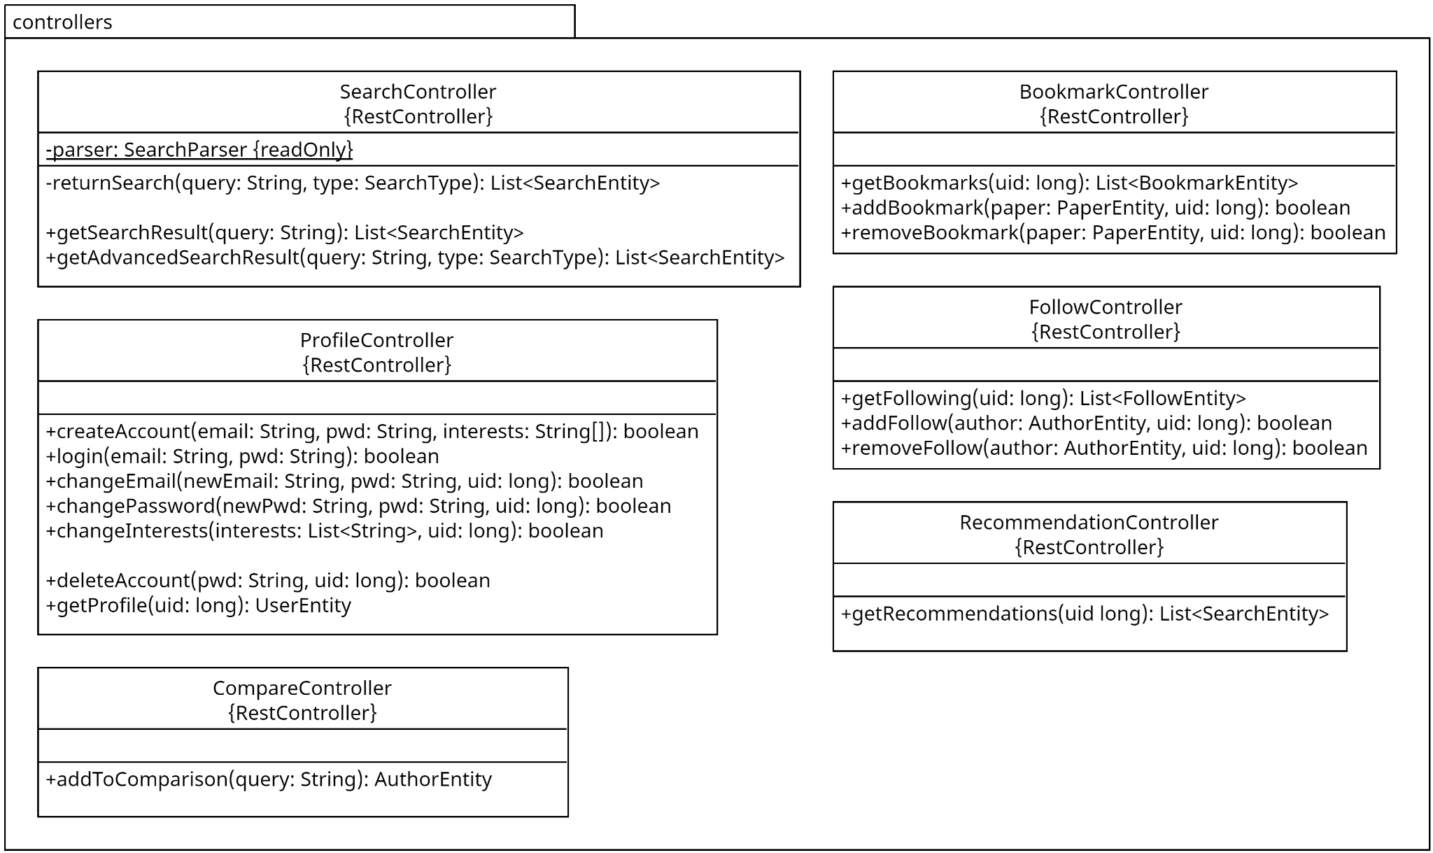
Pablo Schmeiser, Alexander Möhring, Tim Wolk, Adham Gouda, Dominik Jentsch

Slide 14
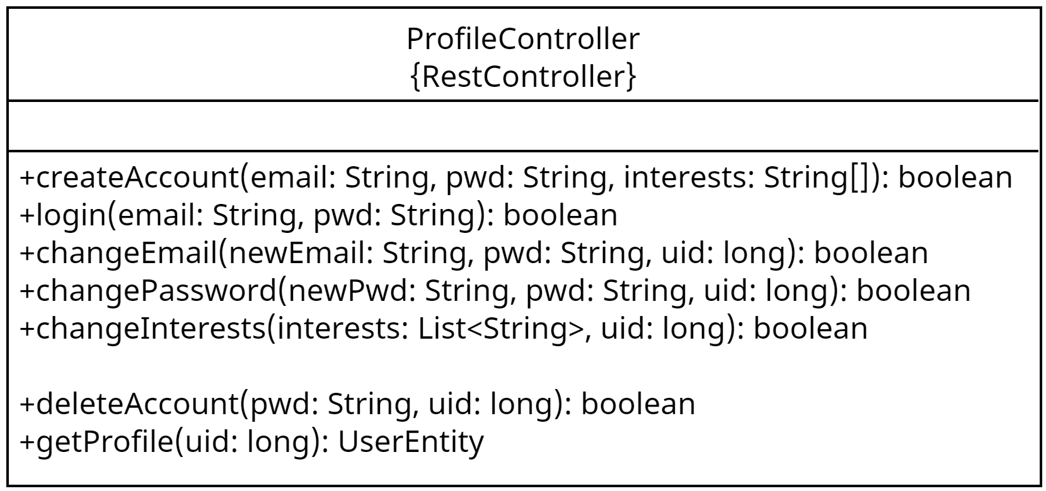
Example
URLs:
createAccount: “/register”
login: “/login”
deleteAccount: “/delete”
…
Pablo Schmeiser, Alexander Möhring, Tim Wolk, Adham Gouda, Dominik Jentsch

Slide 15
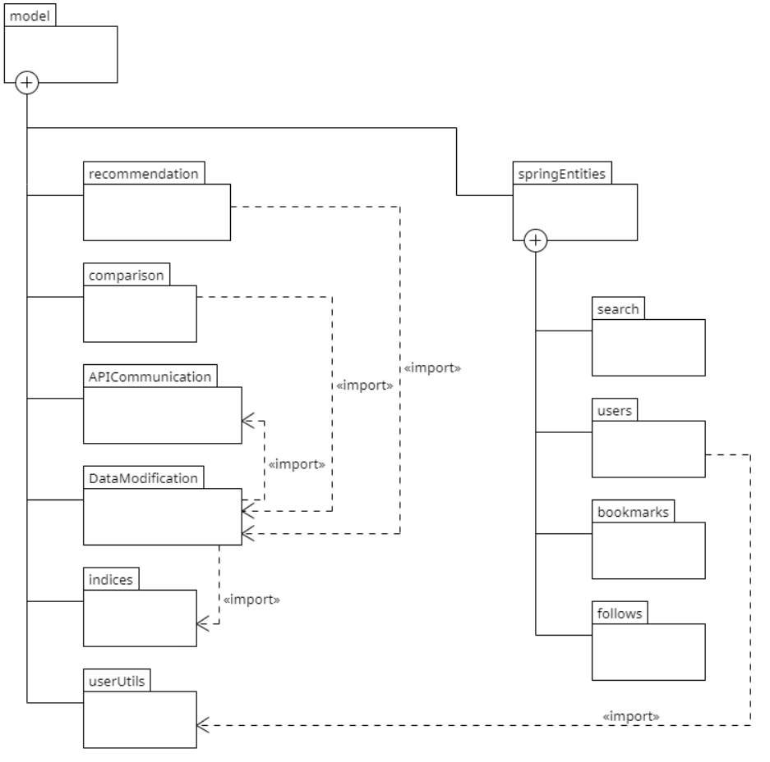
Pablo Schmeiser, Alexander Möhring, Tim Wolk, Adham Gouda, Dominik Jentsch

Slide 16
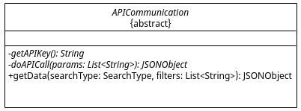
APICommunication
abstract class
two abstract methods
Strategy pattern
Pablo Schmeiser, Alexander Möhring, Tim Wolk, Adham Gouda, Dominik Jentsch

Slide 17
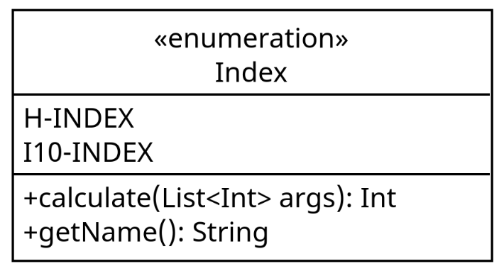
indices
TODO: add pic of indices Enum
two entries currently planned
Easy to add more
Pablo Schmeiser, Alexander Möhring, Tim Wolk, Adham Gouda, Dominik Jentsch

Slide 18
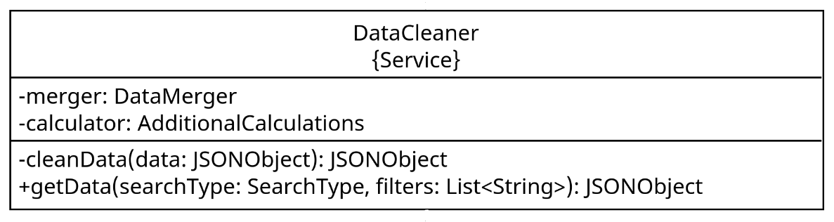
dataModification
TODO: add pic of datacleaner
handles all of the additional calculations
refactoring of the JSON-response
Pablo Schmeiser, Alexander Möhring, Tim Wolk, Adham Gouda, Dominik Jentsch

Slide 19
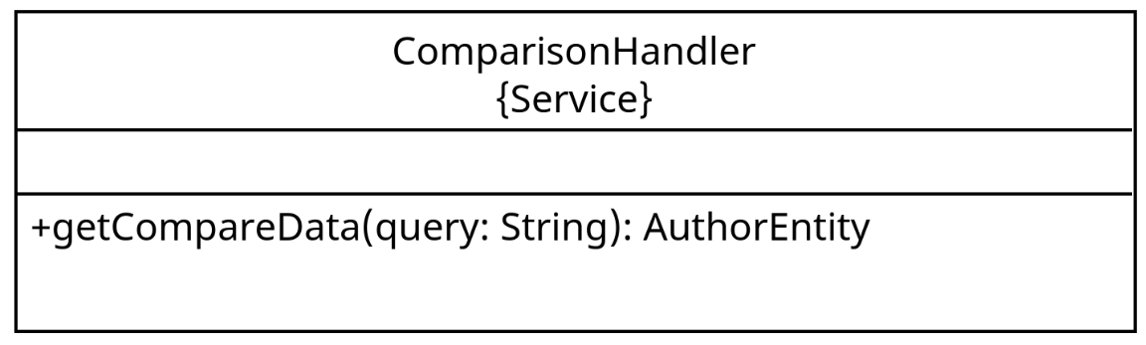
comparison
starts the data request process
Pablo Schmeiser, Alexander Möhring, Tim Wolk, Adham Gouda, Dominik Jentsch

Slide 20
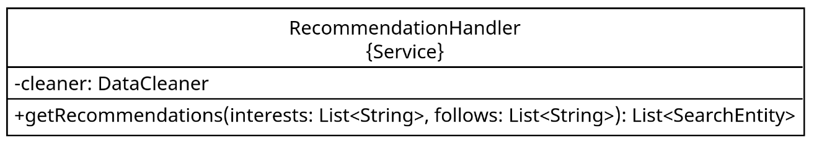
recommendation
handles the recommendation
takes interests from a given profile
starts API call process
Pablo Schmeiser, Alexander Möhring, Tim Wolk, Adham Gouda, Dominik Jentsch

Slide 21
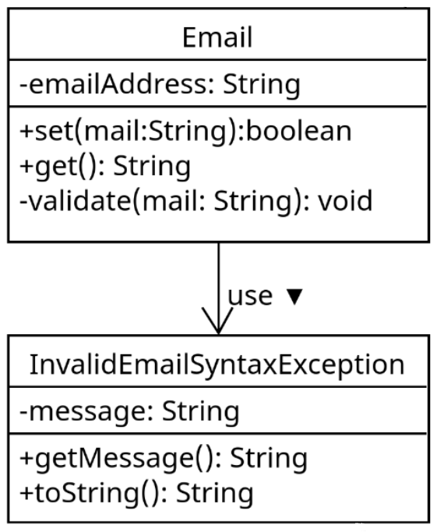
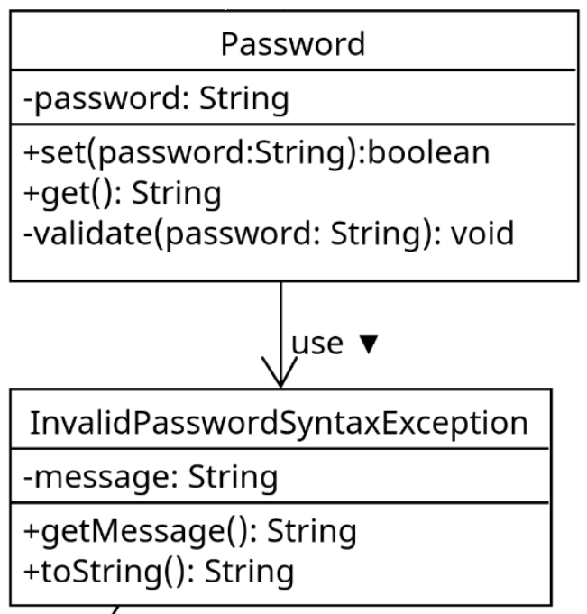
userUtils
:
Pablo Schmeiser, Alexander Möhring, Tim Wolk, Adham Gouda, Dominik Jentsch

Slide 22
springEntities
four subpackages
bookmarks
follows
users
search
groups:
database communication:
bookmarks
follows
users
search
Pablo Schmeiser, Alexander Möhring, Tim Wolk, Adham Gouda, Dominik Jentsch

Slide 23
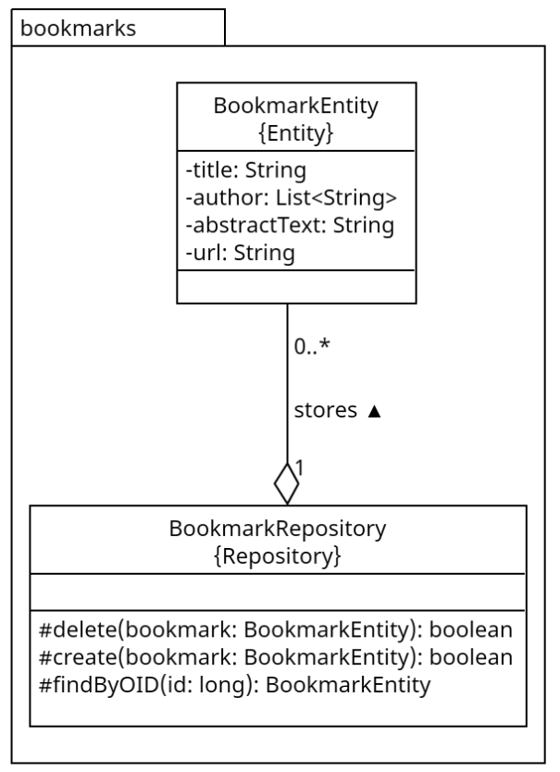
database communication
used to maintain the database
Spring data JPA
Pablo Schmeiser, Alexander Möhring, Tim Wolk, Adham Gouda, Dominik Jentsch

Slide 24
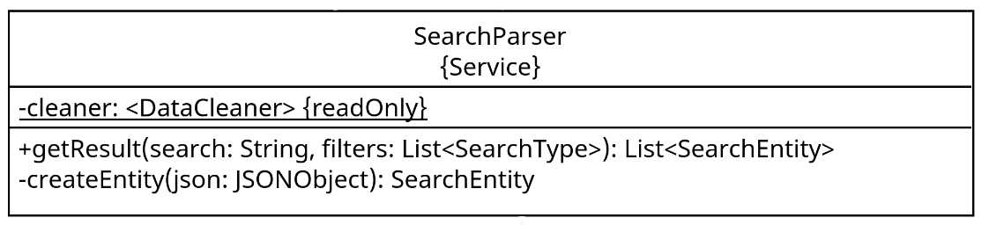
search
consists of searchEntities:
authorEntity
paperEntity
search parser handles the actual search
Pablo Schmeiser, Alexander Möhring, Tim Wolk, Adham Gouda, Dominik Jentsch
Notes:
the search package contains the abstract search Entity class, as well as its subclasses, the author and paper entity. It also holds a search parser and a Search Type Enum.
The search parser is the class, that is accessed by the Search controller and starts the API call process by calling “cleaner.getdata(...)”. once the data from the API call was received, the Parser creates search Entities and and returns those to the Controller, so that they can be displayed to the User.

Slide 25
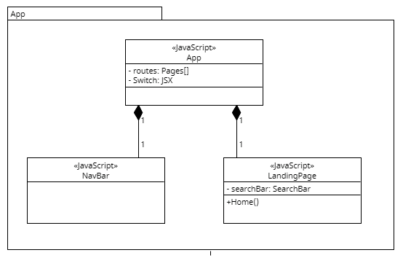
Pablo Schmeiser, Alexander Möhring, Tim Wolk, Adham Gouda, Dominik Jentsch

Slide 26
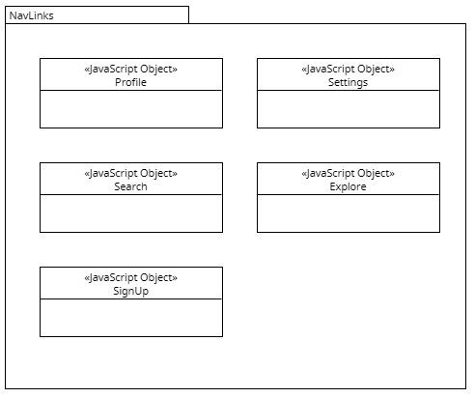
navLinks
links to the different pages
attached to a button in the navBar
Pablo Schmeiser, Alexander Möhring, Tim Wolk, Adham Gouda, Dominik Jentsch

Slide 27
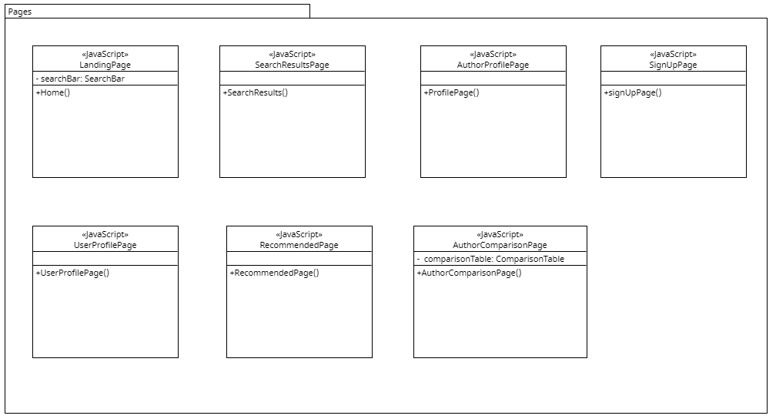
Pablo Schmeiser, Alexander Möhring, Tim Wolk, Adham Gouda, Dominik Jentsch

Slide 28
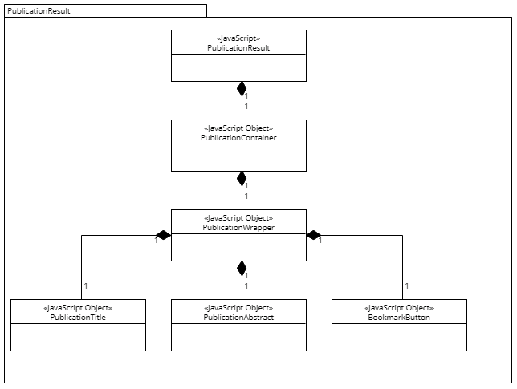
Pablo Schmeiser, Alexander Möhring, Tim Wolk, Adham Gouda, Dominik Jentsch

Slide 29
Sequence and Activity diagrams
Pablo Schmeiser, Alexander Möhring, Tim Wolk, Adham Gouda, Dominik Jentsch

Slide 30
Sequence and Activity diagrams
Sequence:
Login
Paper search
Bookmarking
Author comparison
Following an Author
Recommendations
Activity:
Registration
Paper search
Bookmarking
Pablo Schmeiser, Alexander Möhring, Tim Wolk, Adham Gouda, Dominik Jentsch

Slide 31
Implementation plan
Pablo Schmeiser, Alexander Möhring, Tim Wolk, Adham Gouda, Dominik Jentsch

Slide 32
Implementation groups
Frontend:
Adham
Dominik
Backend:
Pablo
Alexander
Tim
Pablo Schmeiser, Alexander Möhring, Tim Wolk, Adham Gouda, Dominik Jentsch

